Slide 1
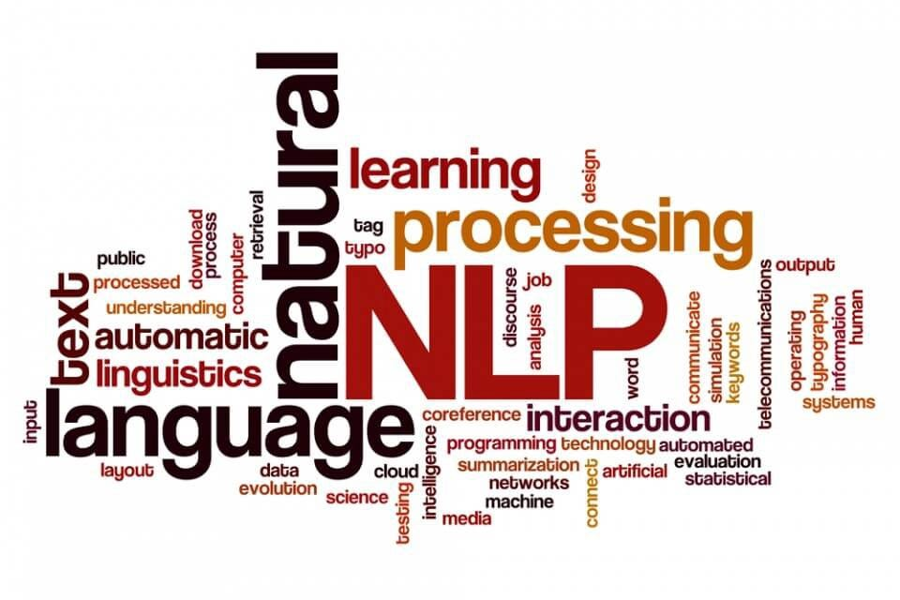
Preprocessing and Text Analytics
Week 3
CSY3055 – Natural Language Processing
Dr Oluseyi Oyedeji

Slide 2
Learning Goals for Week 3
By the end of week three, you should be able to:
Describe and apply key preprocessing techniques.
Implement Bag-of-Words and TF-IDF models.
Explain the difference between frequency-based and weighted features.
Reflect on context-sensitive preprocessing decisions.
Appreciate how these “basic” models still power real-world applications.

Slide 3
Today’s Session
Text Preprocessing
Part-of-Speech (POS) Tagging
Feature Extraction
Bag-of-Words (BOW)
TF-IDF
Exploratory Text Analytics

Slide 4
Introduction
Text is mostly unstructured in its raw form. Machines cannot “read” these; they need proper structure e.g. numbers.
It is necessary to explore how to:
Preprocess text (clean and normalize it)
Extract features (convert it into vectors)
Analyze those features for insights
This is the foundation of all NLP models
From spam filters to chatbots to language models.

Slide 5
Text Preprocessing

Slide 6
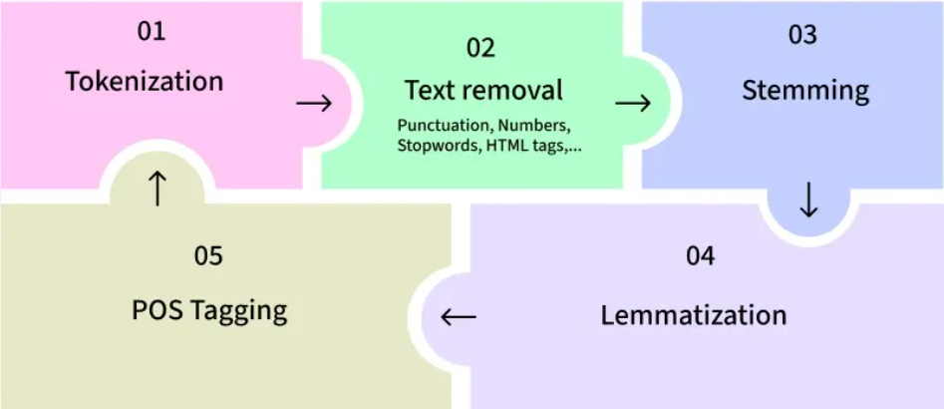
Text Preprocessing
Preprocessing ensures that text is consistent, structured, and informative before numerical transformation.
It means tidying your data before you let a machine learn from it.

Slide 7
Core Preprocessing Steps
Step | Purpose | Example
Lowercasing | Removes case variations | “Free” → “free”
Removing punctuation & symbols | Clears non-textual noise | “WIN!!!” → “win”
Removing numbers | Optional (depends on task) | “Win 1000 now” → “Win now”
Tokenization | Splits text into words | “I love NLP” → [“I”, “love”, “NLP”]
Stopword removal | Removes uninformative words | “the”, “and”, “to”
Lemmatization/Stemming | Reduces to base form | “running” → “run”
Preprocessing extracts the core meaning that is crucial for analysis.

Slide 8
Other Preprocessing Actions
Removing URLS
Removing remove non-word and non-whitespace characters
Handling Contractions (don’t, I’ll, we’ll etc.)
Handling Emojis and Emoticons
Spell Checking
Remove HTML tags
Handling Chat words (u, ur, brb, lol etc.)

Slide 9
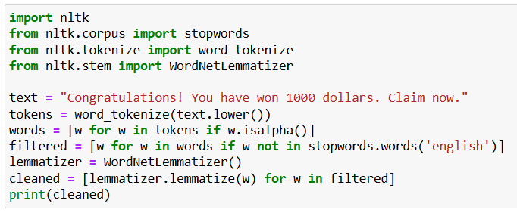
Preprocessing task [Code]

Slide 10
Context-Specific Preprocessing
Domain | Adjustments
Social Media | Retain emojis, hashtags; handle @mentions
Legal/Medical | Keep numbers and acronyms
Chatbots | Keep pronouns and contractions
Multilingual corpora | Detect language before cleaning
Deep learning pipelines | Minimal preprocessing
Traditional ML (BoW/TF-IDF) | Heavier cleaning, full normalization
Principle: Strike a balance between noise removal and information preservation

Slide 11
Part-of-Speech Tagging

Slide 12
Part-of-Speech Tagging
Part-of-Speech (POS) Tagging may not be completely considered a preprocessing technique
It usually exists between the Preprocessing and Feature Extraction Stage in the NLP pipeline
Part-of-Speech (POS) tagging is the process of assigning a grammatical category (e.g., noun, verb, adjective) to each word in a sentence.

Slide 13
Part-of-Speech Tagging – Example 1
Sentence
"The cat sat on the mat."
Tagged
[('The', 'DET'), ('cat', 'NOUN'), ('sat', 'VERB'), ('on', 'ADP'), ('the', 'DET'), ('mat', 'NOUN')]

Slide 14
Part-of-Speech Tagging – Example 2
Sentence
"Artificial intelligence is transforming industries."
Tagged
[('Artificial', 'ADJ'), ('intelligence', 'NOUN'), ('is', 'VERB'), ('transforming', 'VERB'), ('industries', 'NOUN')]

Slide 15
POS Tagging Matters
Application | Role of POS Tagging
Information extraction | Identify entities and relationships
Sentiment analysis | Adjectives/adverbs carry emotion
Text classification | Improves features for ML models
Translation | Maintains grammatical order
Chatbots | Understands question type

Slide 16
Universal POS Tagsets
Tag | Meaning | Example
NOUN | Noun | student, book
VERB | Verb | study, learn
ADJ | Adjective | smart, busy
ADV | Adverb | quickly, very
PRON | Pronoun | he, they
DET | Determiner | the, a
ADP | Adposition | in, on, at
CONJ | Conjunction | and, but
NUM | Numeral | one, ten
INTJ | Interjection | wow, oh
used in NLTK/spaCy

Slide 17
POS Tagging Methods
Rule-Based
Uses grammar rules and dictionaries.
E.g. words ending in -ly = adverbs.
Statistical
Uses probabilities from labelled data (e.g., Hidden Markov Models).
Predicts most likely tag sequence.
Neural
Deep learning (LSTM, Transformer).
Learns context automatically
Has best accuracy.

Slide 18
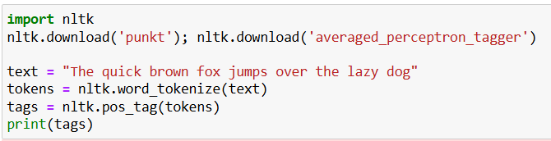
POS Tagging with NLTK
NLTK uses the Penn Treebank tagset (e.g., JJ = adjective, NN = noun)

Slide 19
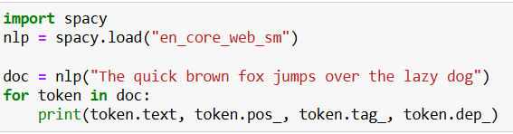
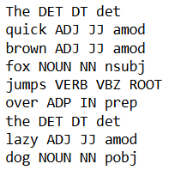
POS Tagging with spaCy
spaCy provides POS, fine-grained tags, and dependency relations.

Slide 20
POS Tagging for Feature Engineering
Keep nouns
topics and entities
Keep adjectives/adverbs
sentiment-bearing words
Remove determiners, prepositions, etc.
Use filtered text for TF-IDF or embeddings

Slide 21
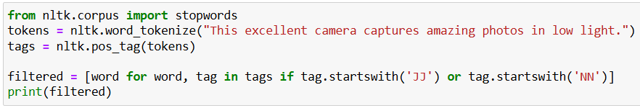
Using POS Tags to Filter Words
Some POS tagging challenges includes Ambiguity, informal texts, Domain variation
and language differences

Slide 22
Feature Extraction

Slide 23
Bag-of-Words (BoW)
Represents text as a “bag” of words, ignoring grammar and word order.
Each document becomes a vector of word counts.
Document | win | money | claim | now
“Win money now” | 1 | 1 | 0 | 1
“Claim your prize now” | 0 | 0 | 1 | 1

Slide 24
N-grams
N-grams are sequences of N consecutive words.
Unigrams (n=1): “win”, “money”, “now”
Bigrams (n=2): “win money”, “money now”
Trigrams (n=3): “claim your prize”
N-grams define what goes into the Bag-of-Words model, more context, richer features.

Slide 25
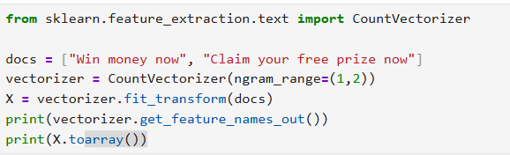
N-grams [Code]
Each row = document; each column = token; values = word counts.
Notes:
Tokenisation can be seen as a segmentation problem, deciding how to split text into meaningful units. The model searches for the segmentation (s) that’s most probable given the input (x). In other words, it finds the most likely way to “cut” the text. This mirrors how humans also segment language mentally when reading or listening.

Slide 26
TF-IDF (Term Frequency–Inverse Document Frequency)

Slide 27
TF-IDF
Statistical method used in NLP and information retrieval to evaluate how important a word is to a document in relation to a larger collection of documents.
The problem In BoW is that common words dominate.
TF-IDF solves this by adjusting word weights by rarity.

Slide 28
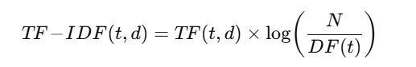
TF-IDF contd.
where
TF(t,d) = term frequency of t in d
DF(t) = number of documents containing t
N = total documents
log(N / DF(t)) = inverse document frequency

Slide 29
TF-IDF contd.
Interpretation
High TF = frequent in a document
Low DF = rare across documents
Result = higher importance

Slide 30
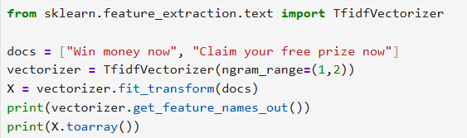
TF-IDF [CODE]

Slide 31
BoW vs TF-IDF
Aspect | Bag-of-Words | TF-IDF
Representation | Raw counts | Weighted counts
Common words | Dominant | Down-weighted
Unique words | Equal treatment | Up-weighted
Vector type | Integer | Float
Emphasis | Frequency | Informativeness
Example Use | Quick baseline | Discriminative models
BoW counts every voice; TF-IDF amplifies unique ones.

Slide 32
Exploratory Text Analytics
Understand what your text “says” before modeling.

Slide 33
Exploratory Text Analytics
Recap from Week 1
Frequency Distribution
Rank most common terms to see vocabulary richness and noise
Word Cloud
Visual summary of word frequencies.
Class Comparison

Slide 34
Industry Applications
Application | BoW/TF-IDF Role
Email Spam Detection | Classic Naïve Bayes + TF-IDF
Search Engines (Lucene/BM25) | TF-IDF-based ranking
Customer Feedback Analysis | Sentiment scoring
Fake News Detection | Frequency + stylistic features
Recommendation Systems | Similarity using TF-IDF vectors

Slide 35
Transition to Modern NLP
Modern models (like BERT, GPT, and word2vec) learn their own representations, replacing manual feature engineering.
But understanding BoW and TF-IDF is essential
They form the conceptual DNA of how machines process text.
Before machines could understand meaning, they had to learn to count.

Slide 36
Ethics, Fairness & Transparency
Dataset Imbalance
Unequal spam/ham distribution causes bias , fix via balancing or weighting.
Preprocessing Bias
Removing rare dialect or slang terms can erase identity markers.
Transparency
Always document (record) preprocessing, it’s part of ethical AI practice.
Bias can start as early as data cleaning.

Slide 37
Summary
Preprocessing = cleaning text.
Feature Extraction = turning text into numbers.
BoW counts; TF-IDF weighs importance.
N-grams capture local order.
Fairness and ethics matter early.
These foundations still power real-world NLP.

Slide 38
Thank you

